Slide 1

The Children of
Burton Elementary School
2015-16 School Year

Slide 2
Where Stars Shine

Slide 3
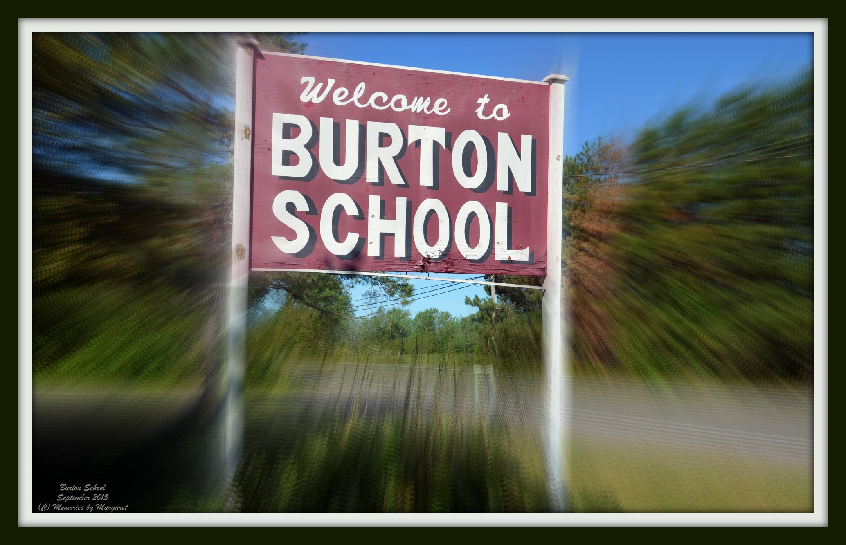

Slide 4
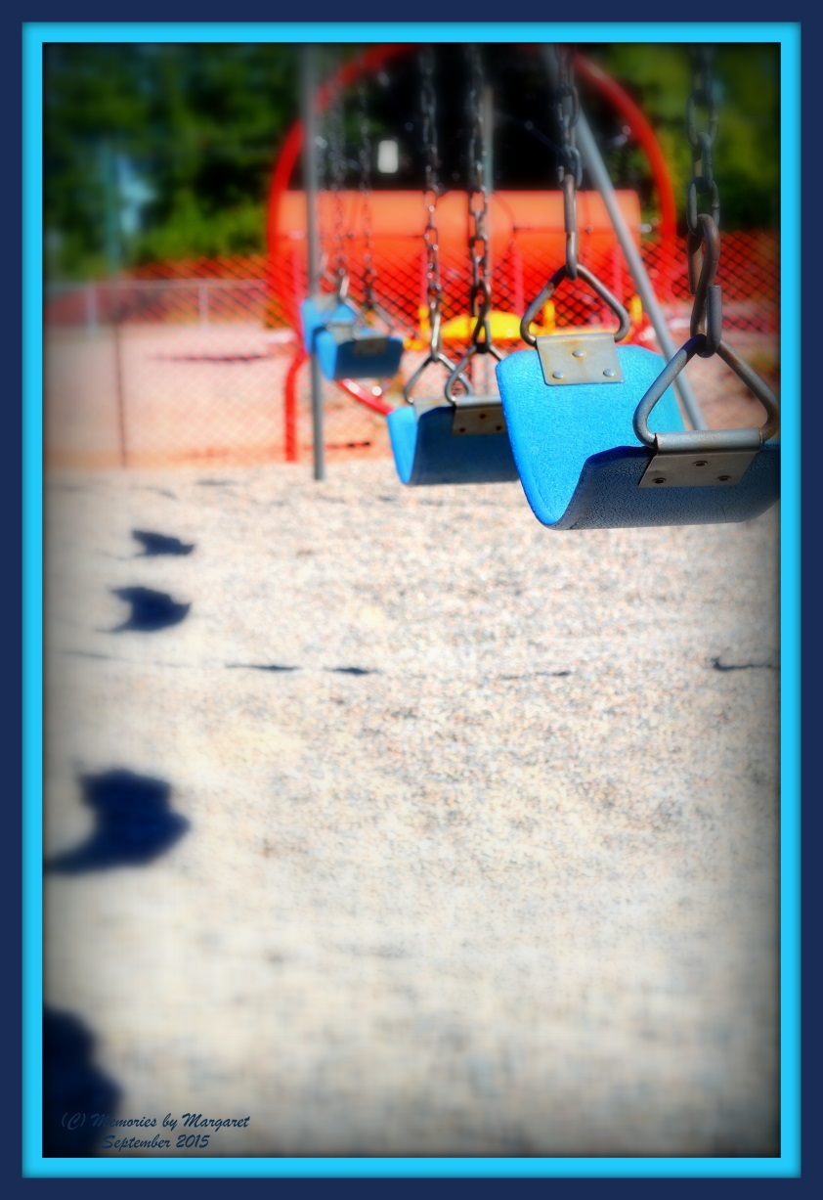
All quiet………….waiting……..… for the joyful reunion in September!

Slide 5
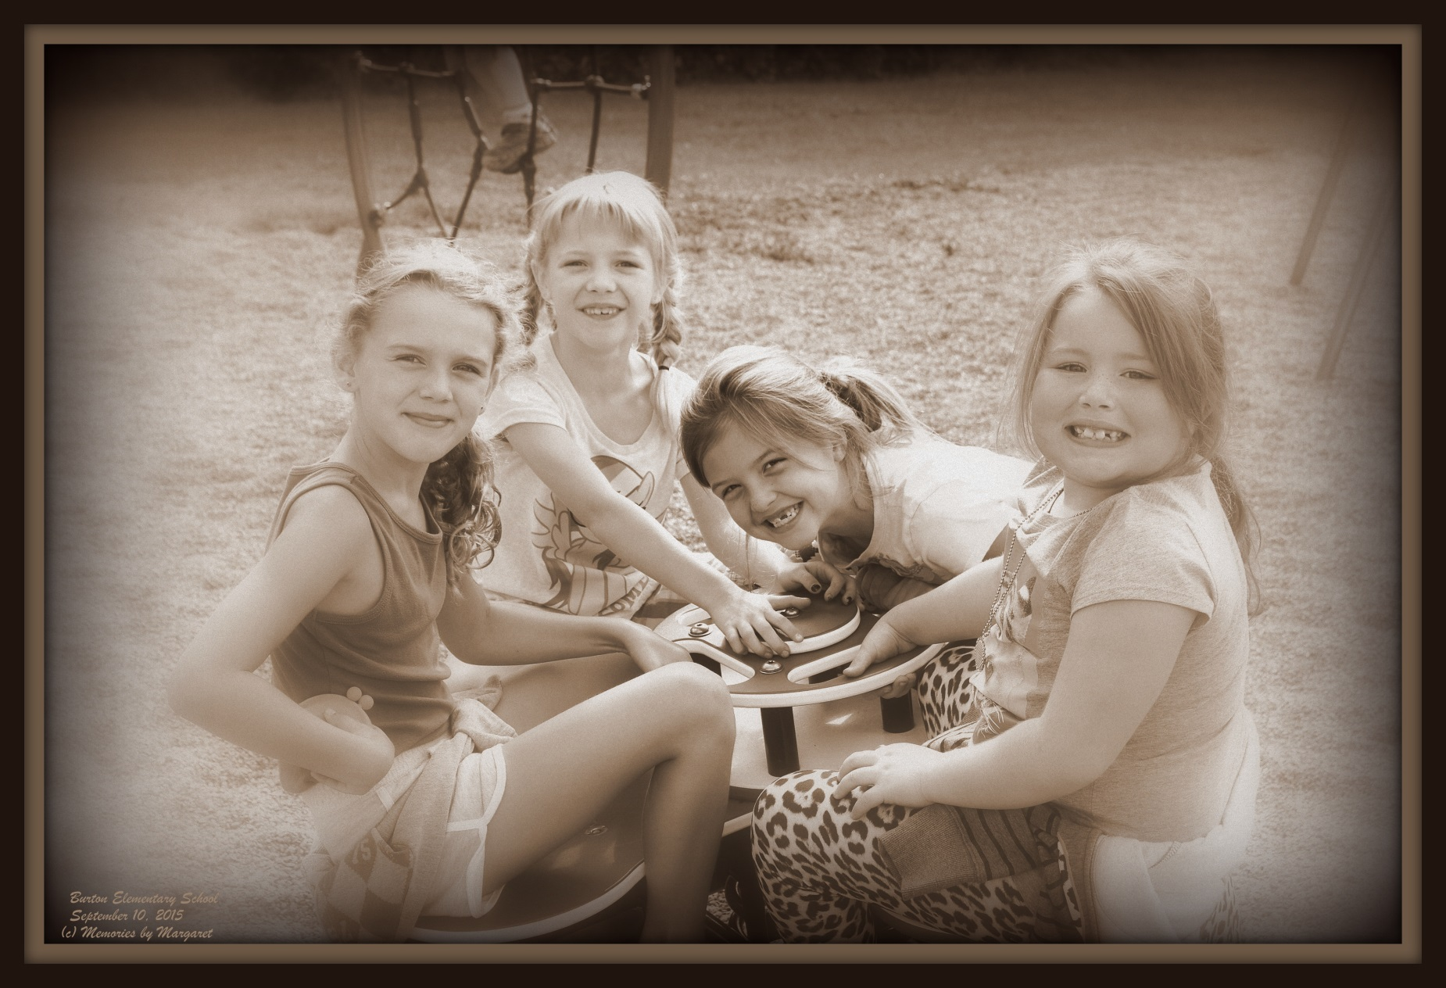
Yayyyyy…...they’re B A C K!!

Slide 6
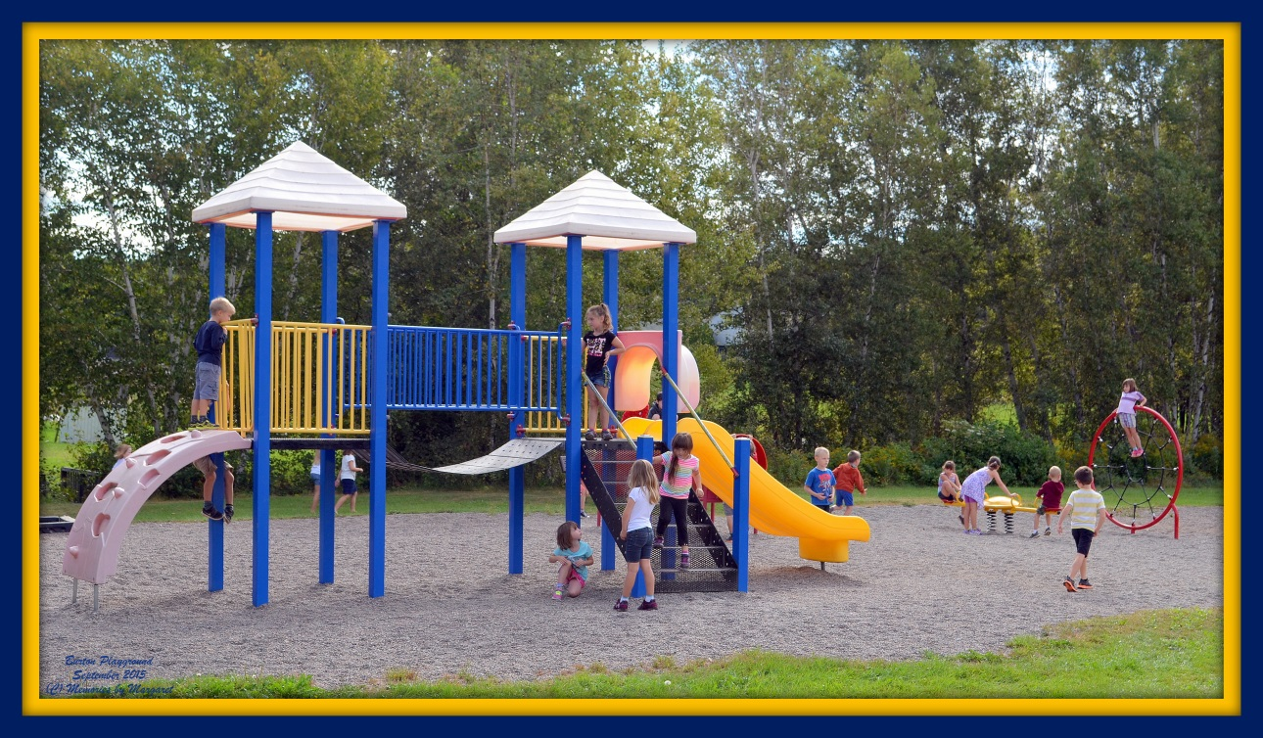
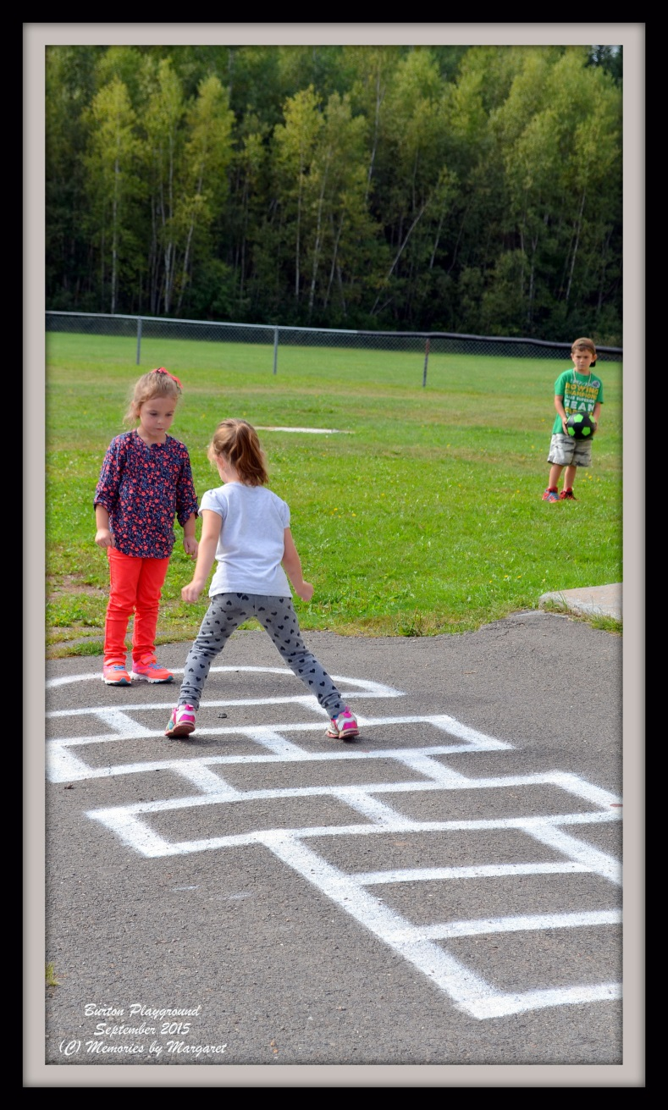
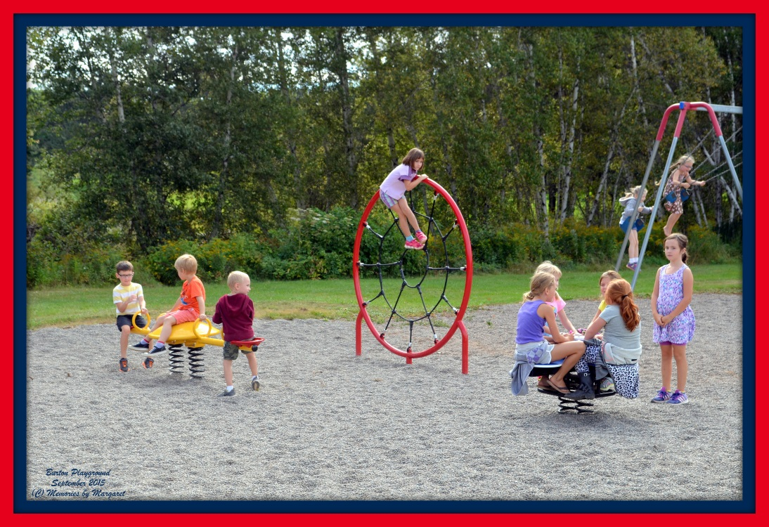

Slide 7
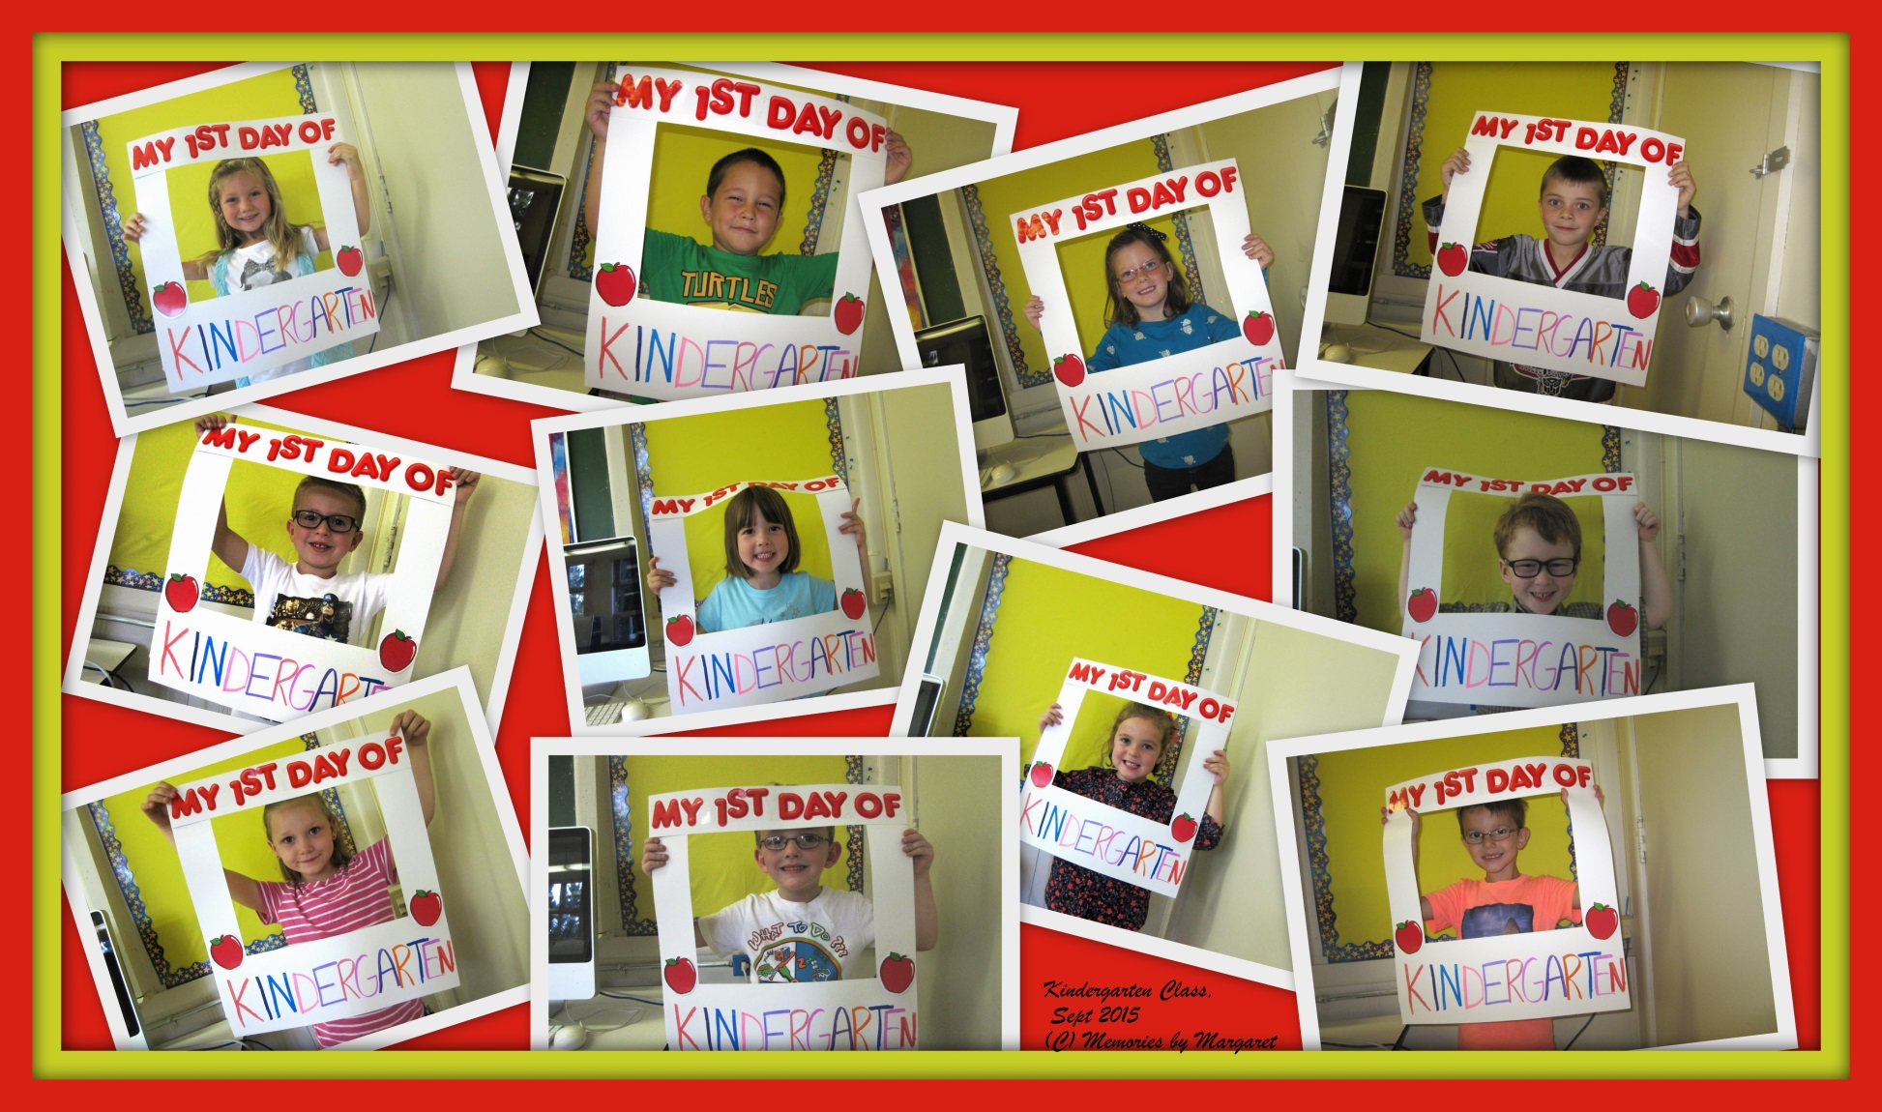
Graduates of 2028!
Kindergarten Class of 2015-16

Slide 8
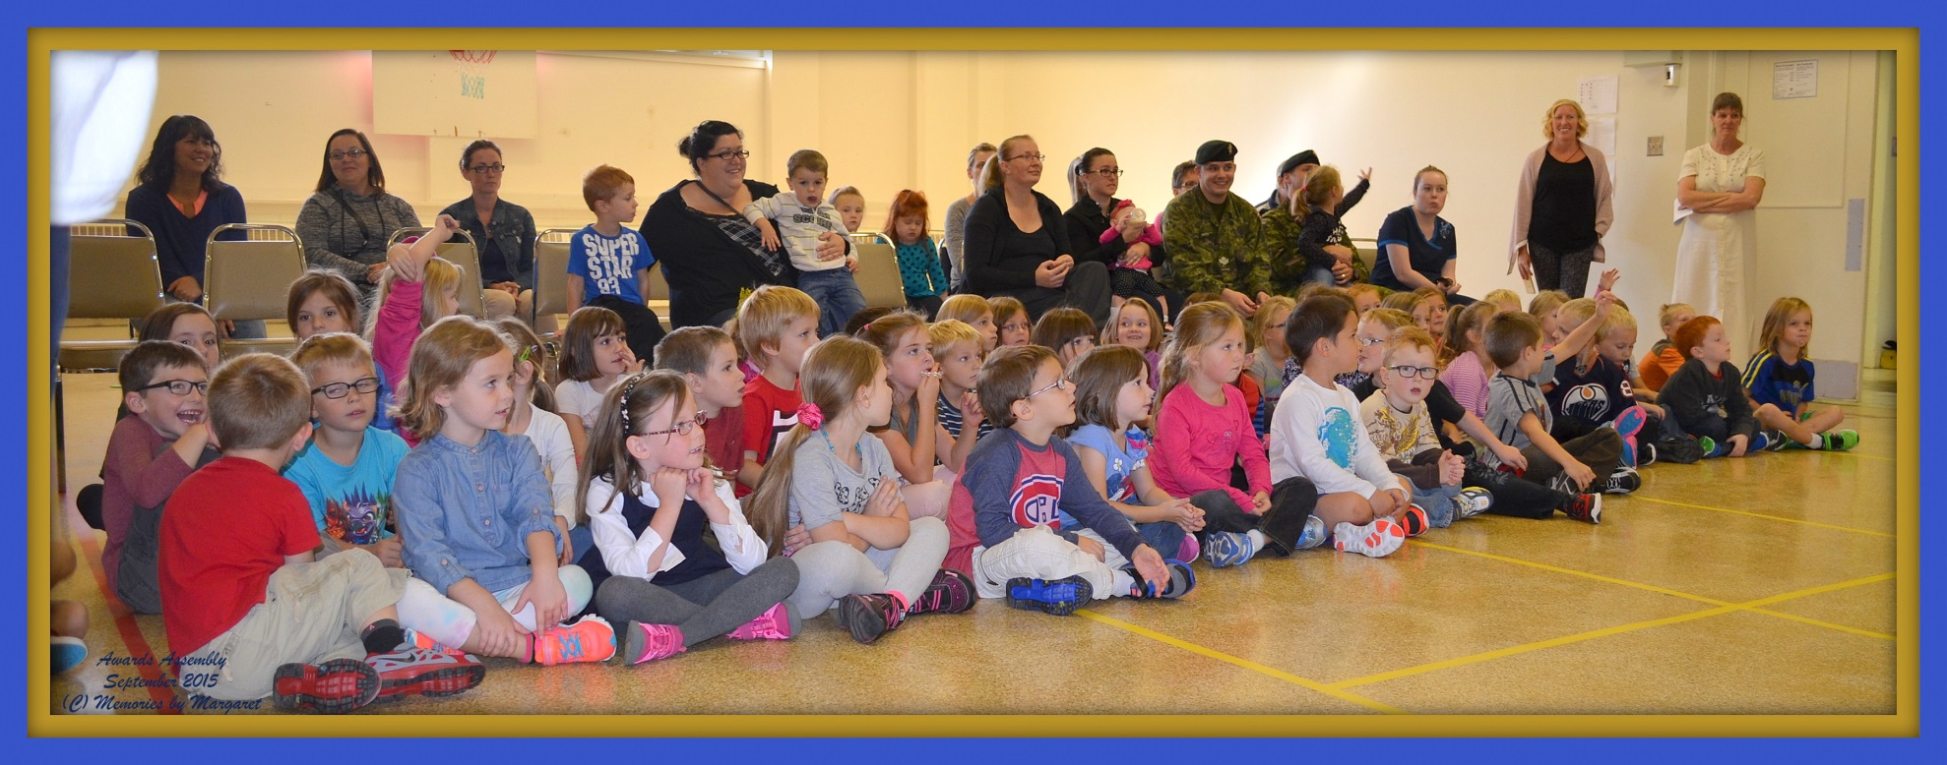
Monthly Awards Assembly
Themes
September: “Bucket Filling”
October: “Cooperation”
November: “Courtesy”

Slide 9
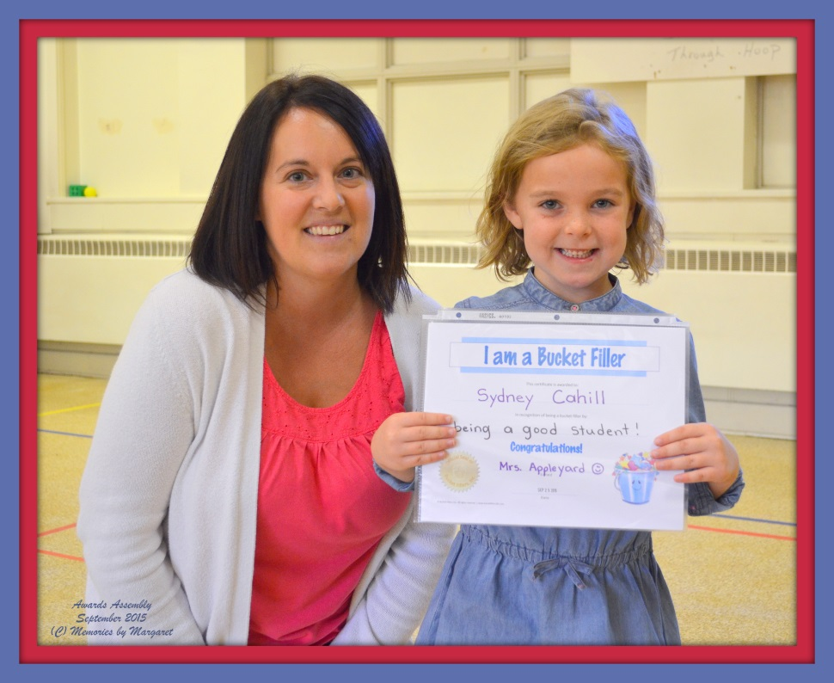
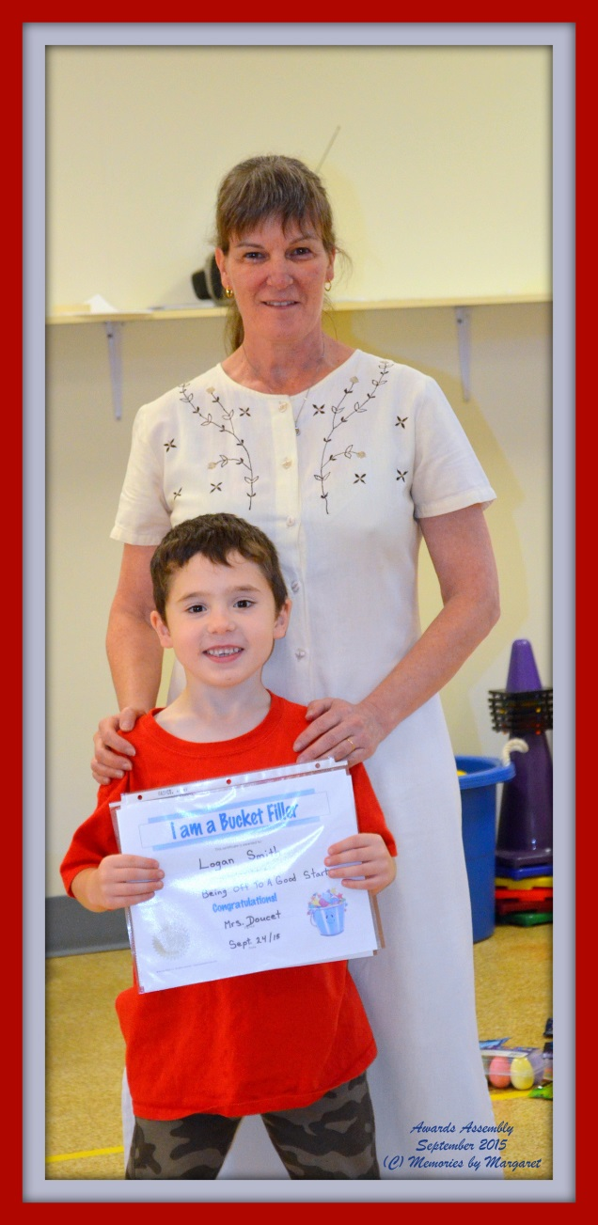
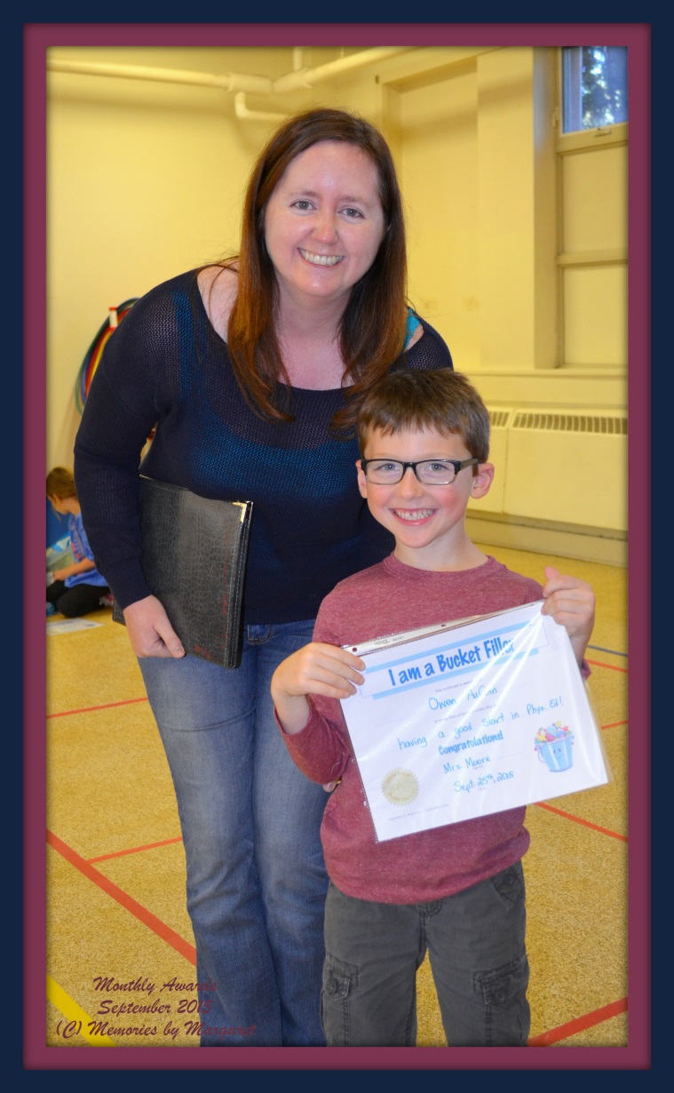
September Awards

Slide 10
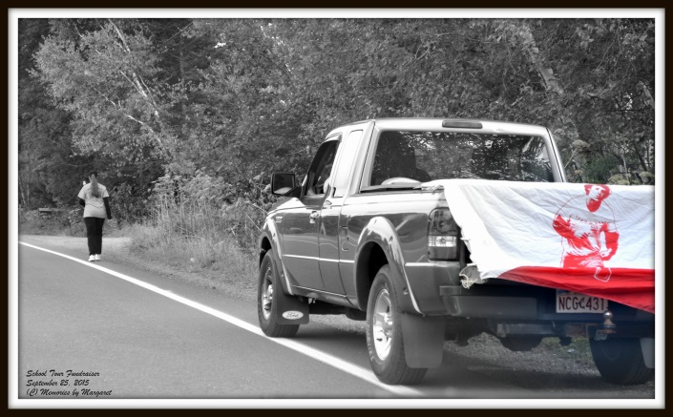
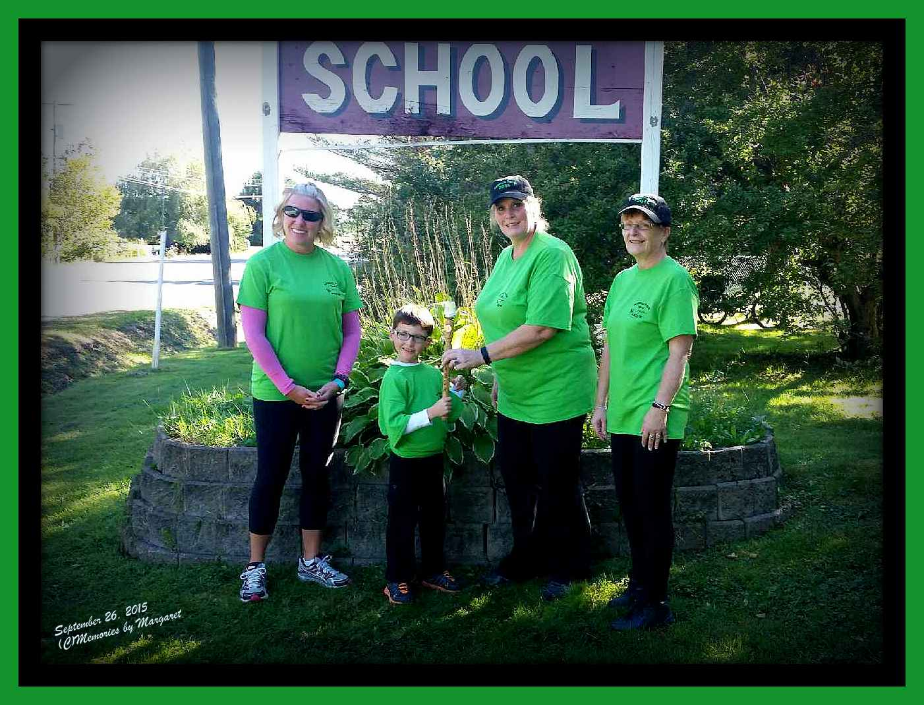
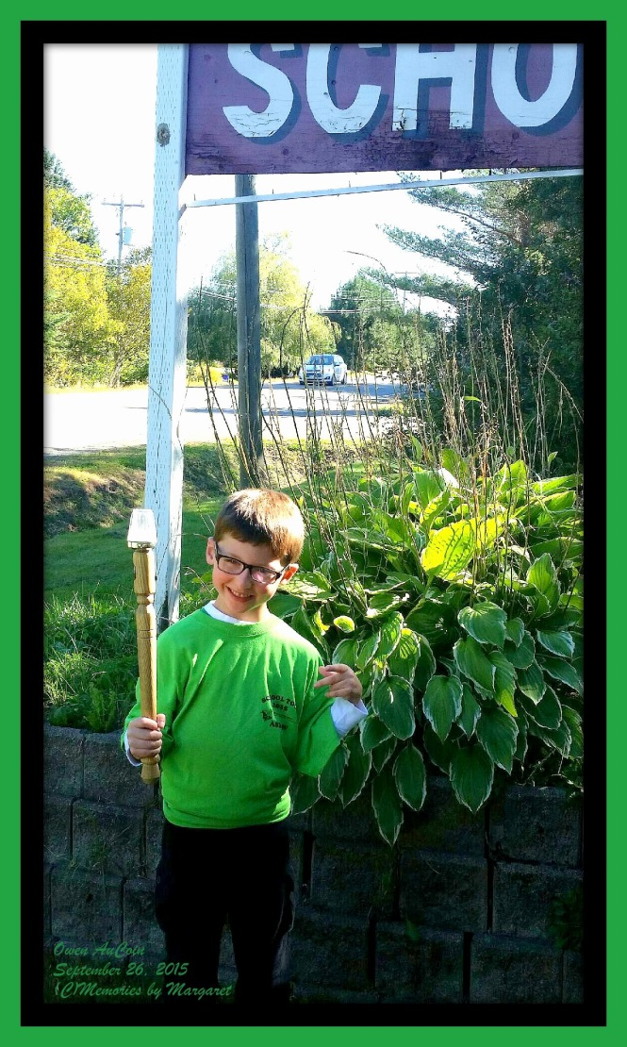
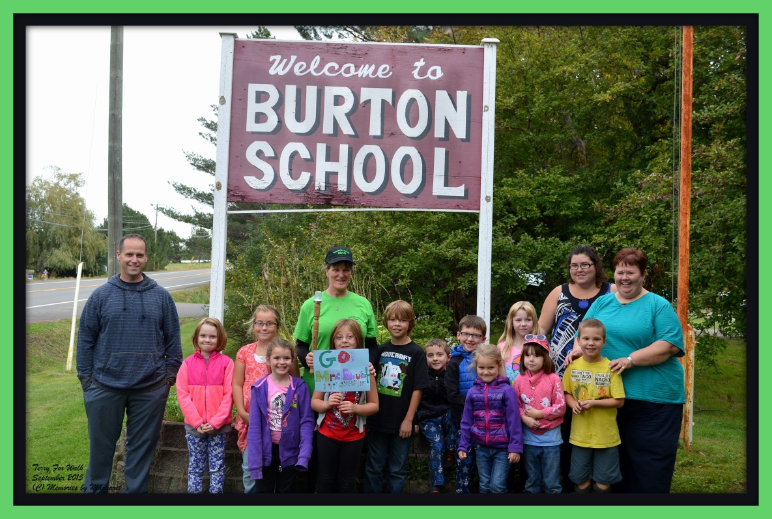
Terry Fox
Walk
2015

Slide 11
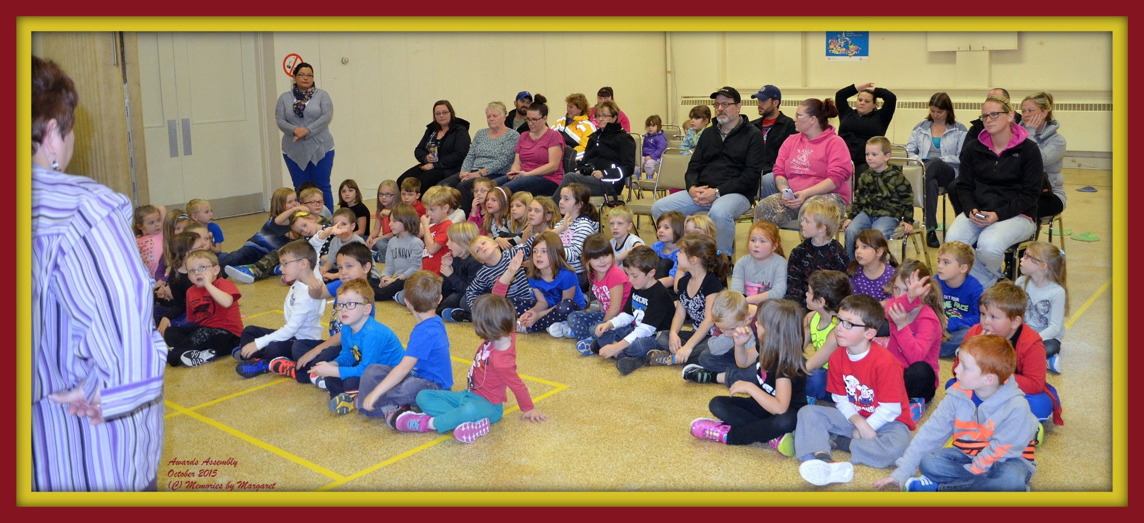
October Assembly

Slide 12
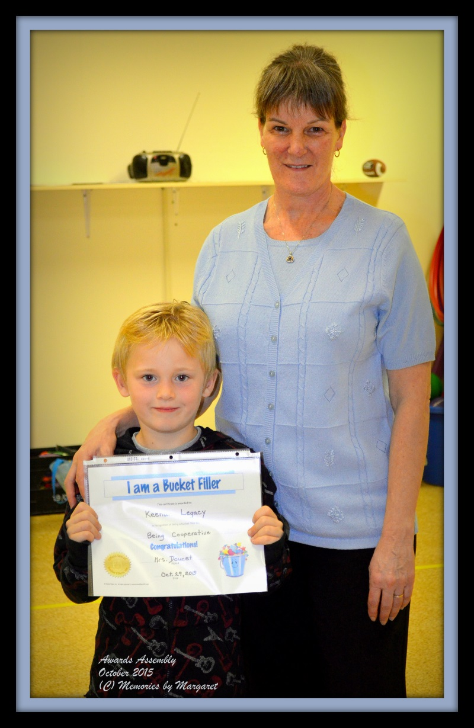
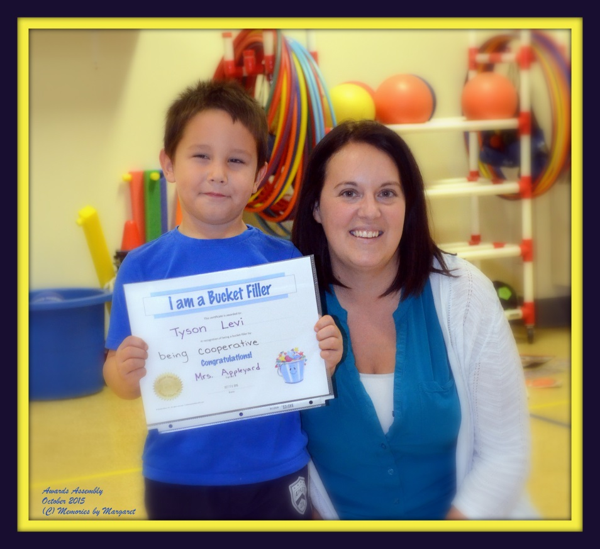
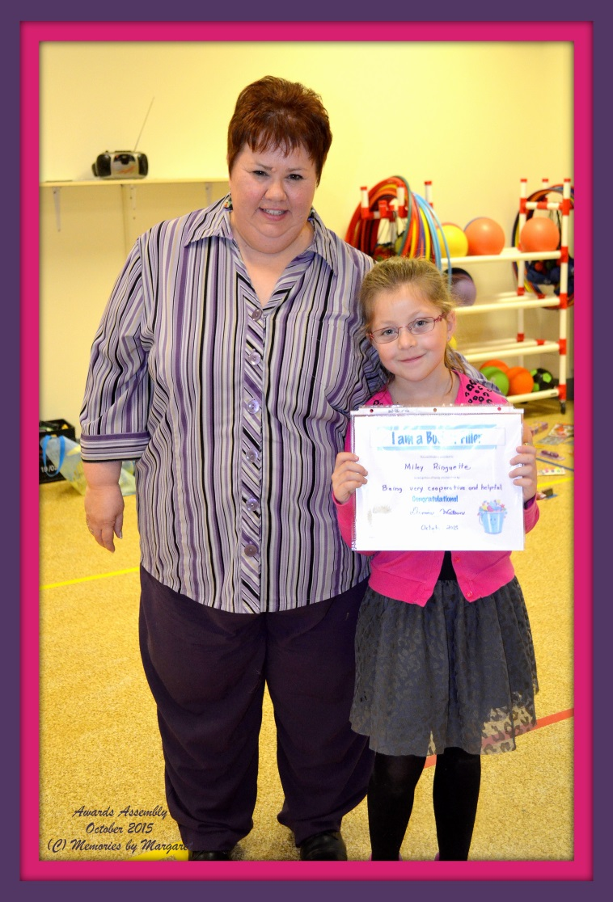
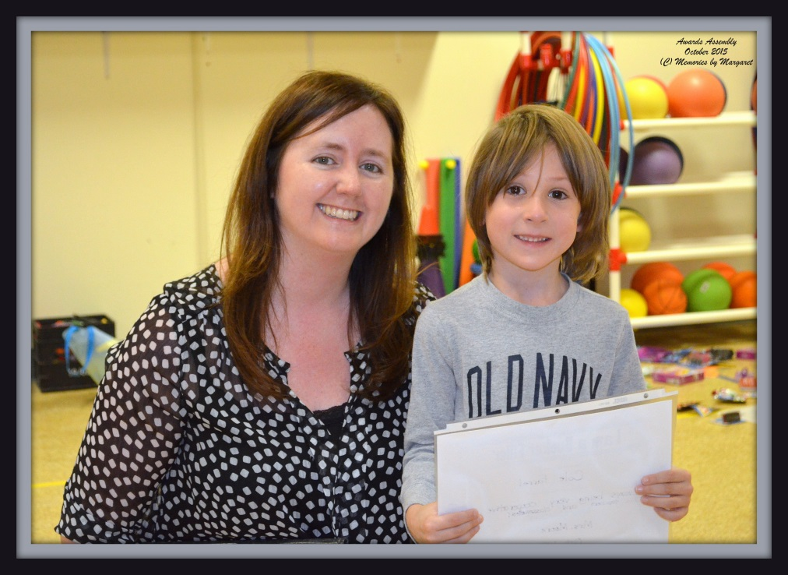
October Awards

Slide 13
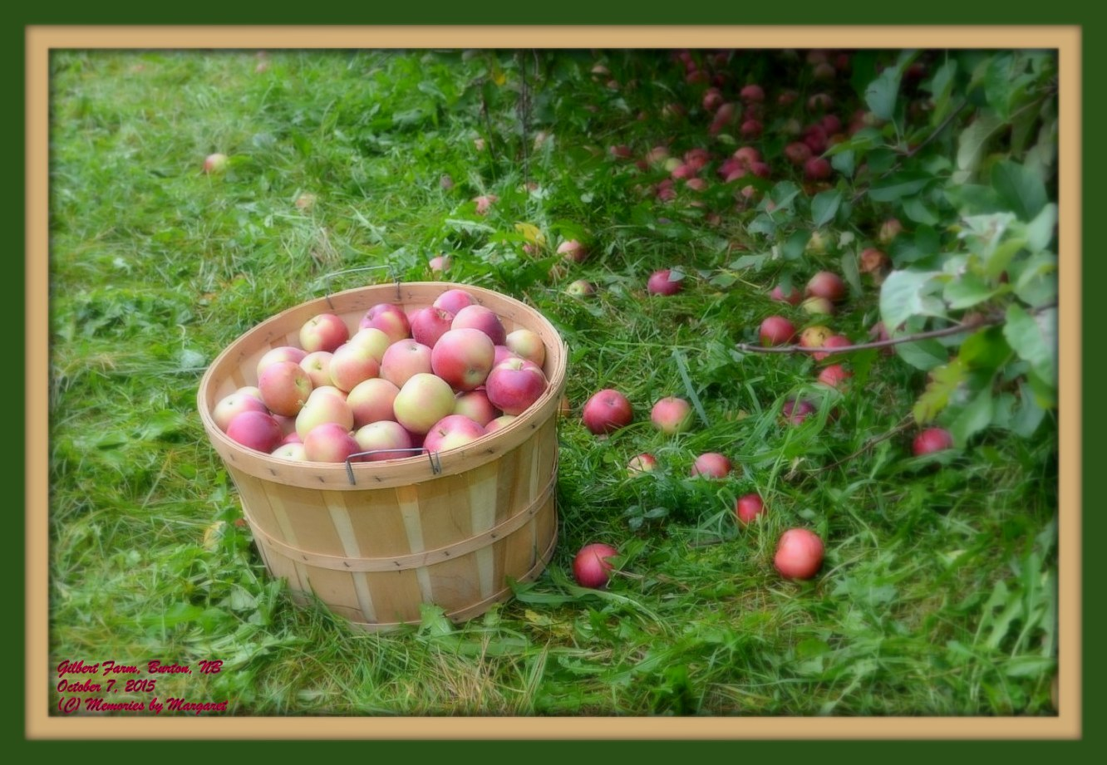
Field Trip!
To ‘Gilbert Farm’, Burton, NB

Slide 14
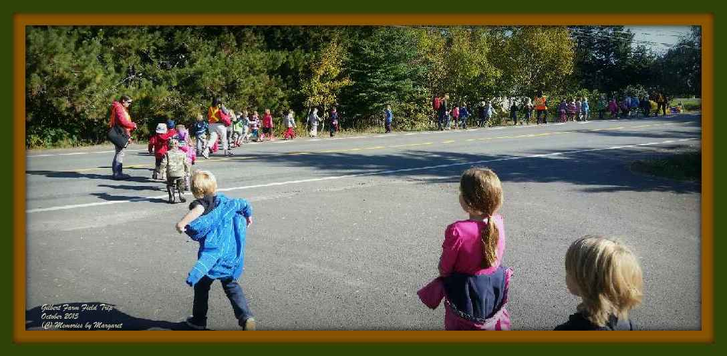
……….and off they go ☺

Slide 15
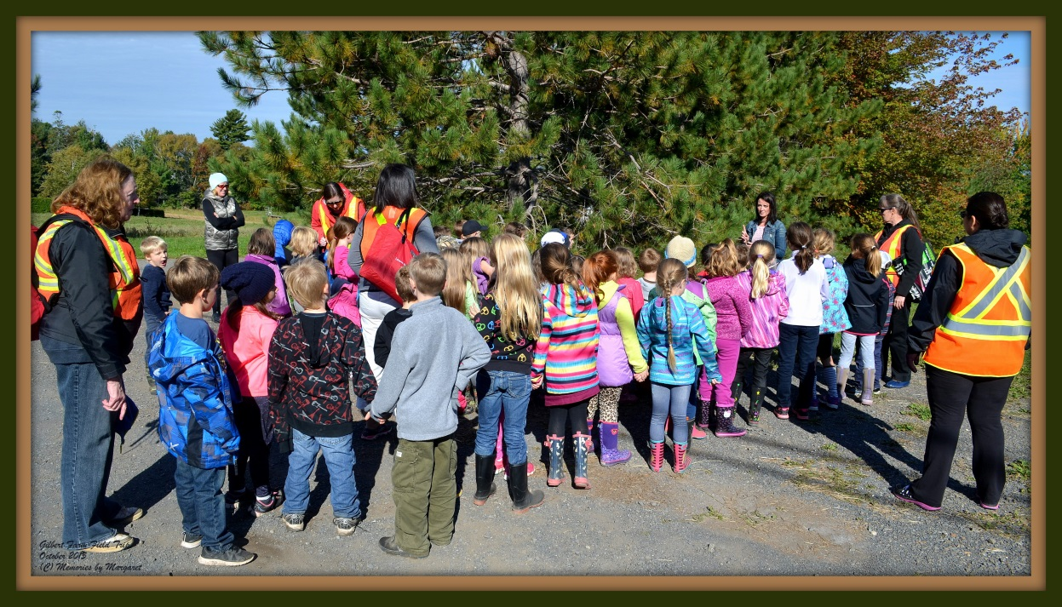
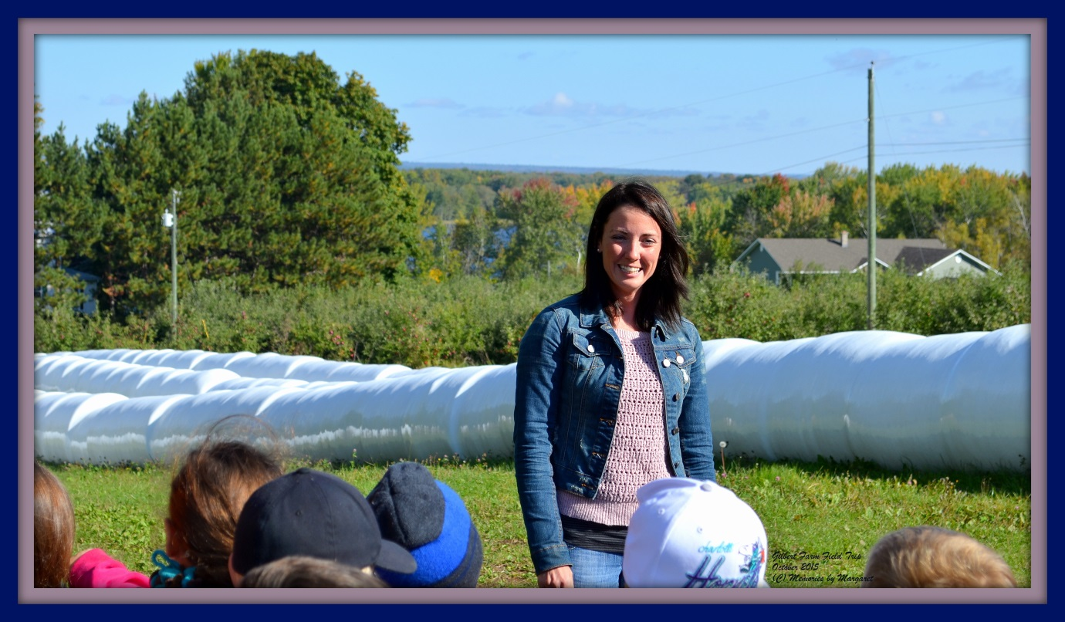
Our Welcome at the Farm…..
Thank you to Caitlin’s mom,
Melisa Ashburne

Slide 16
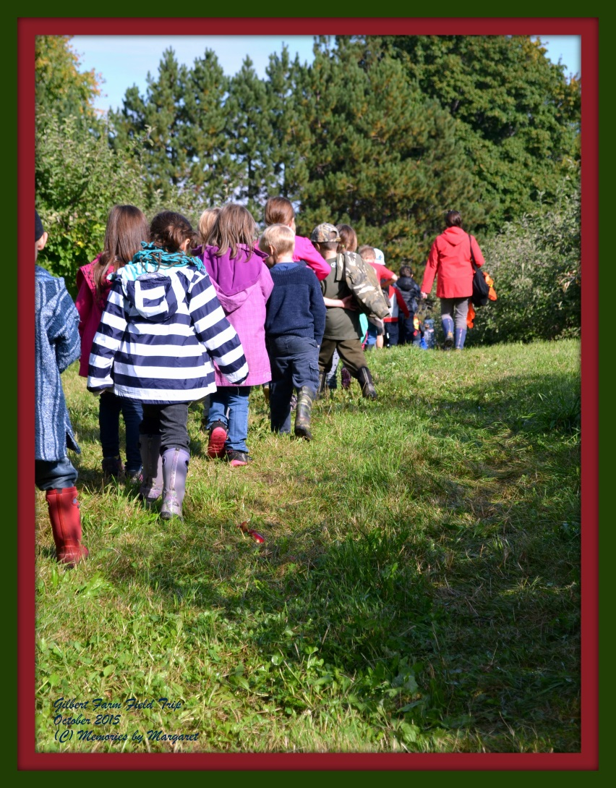
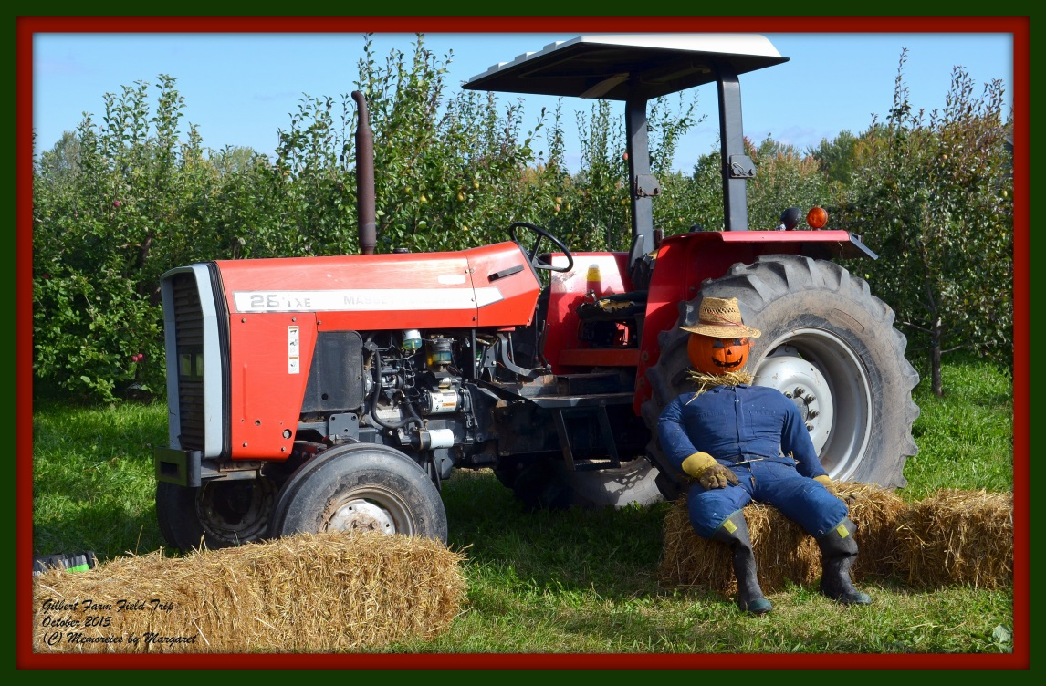
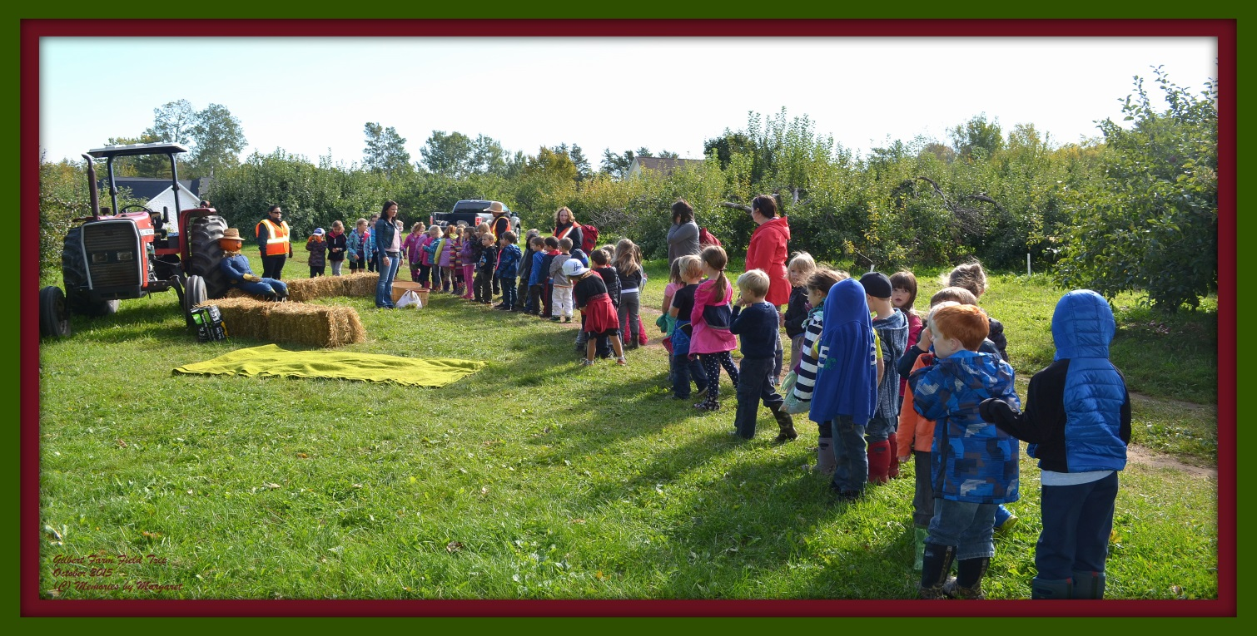

Slide 17
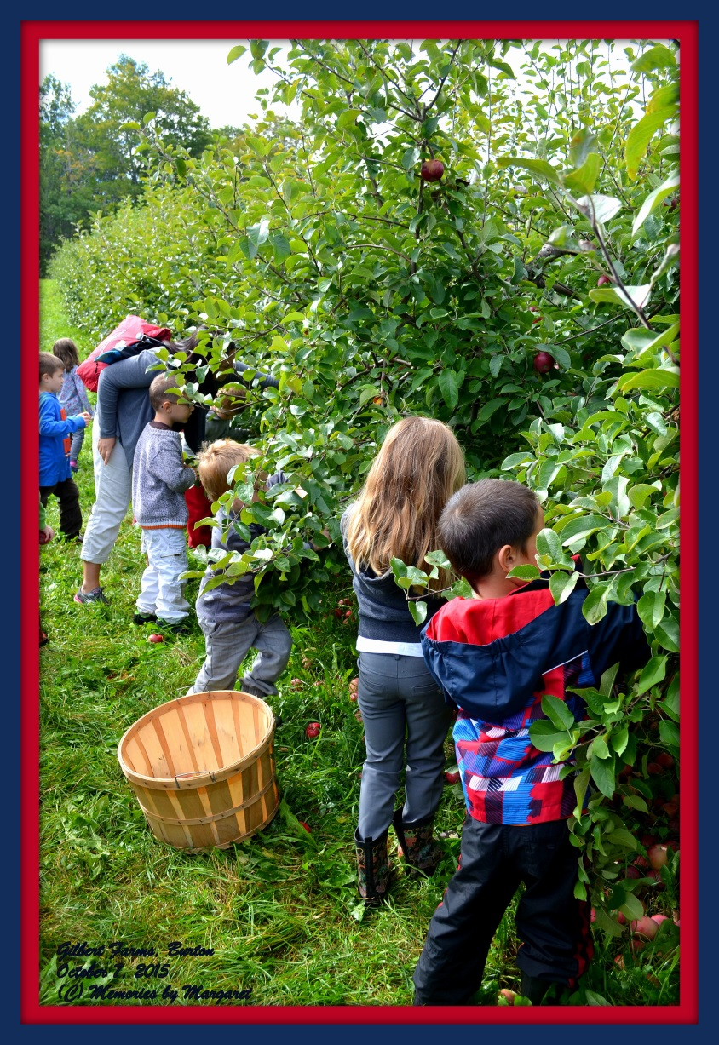
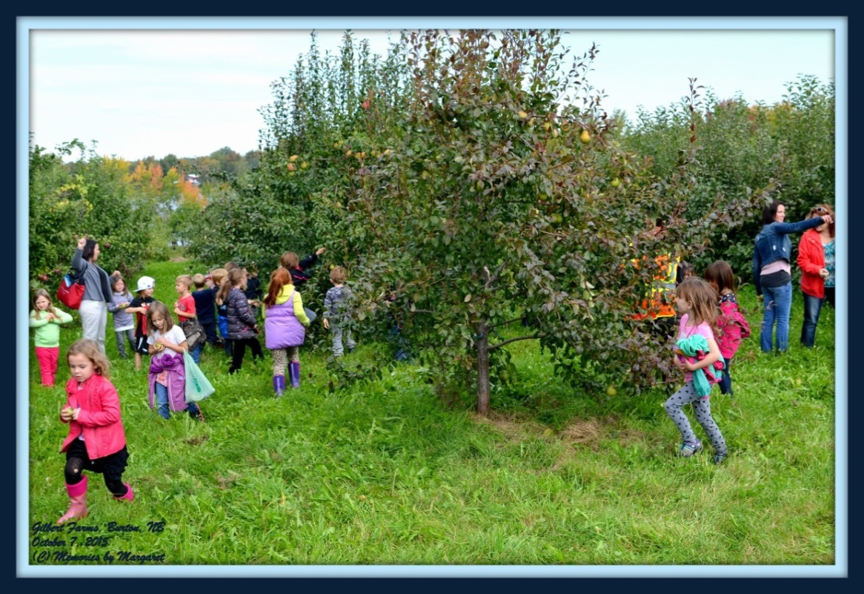
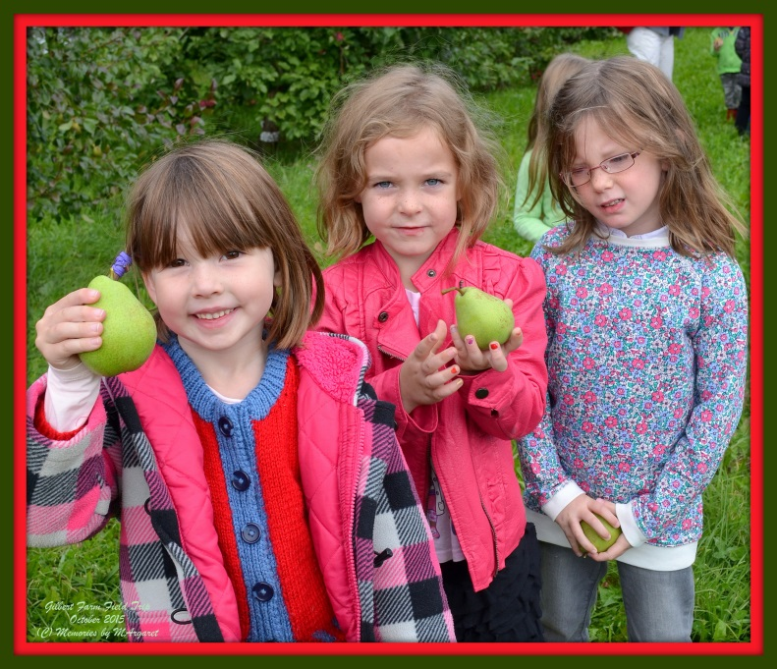
Students gathering their crops……..

Slide 18
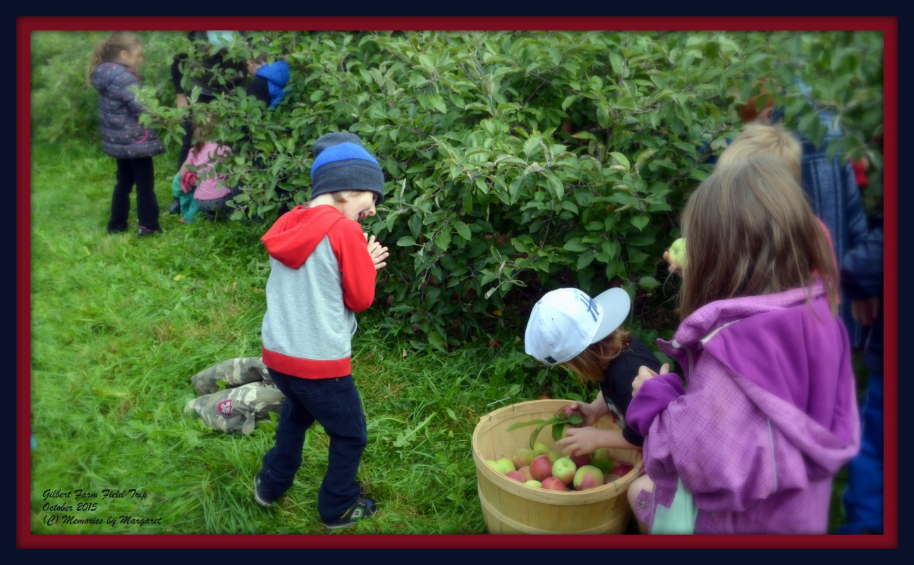
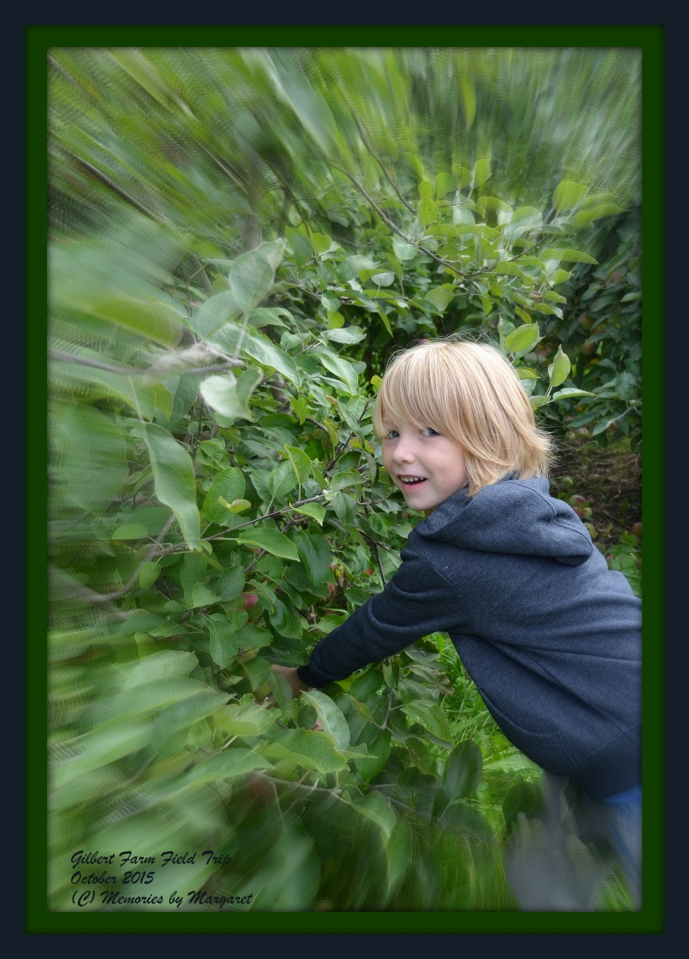
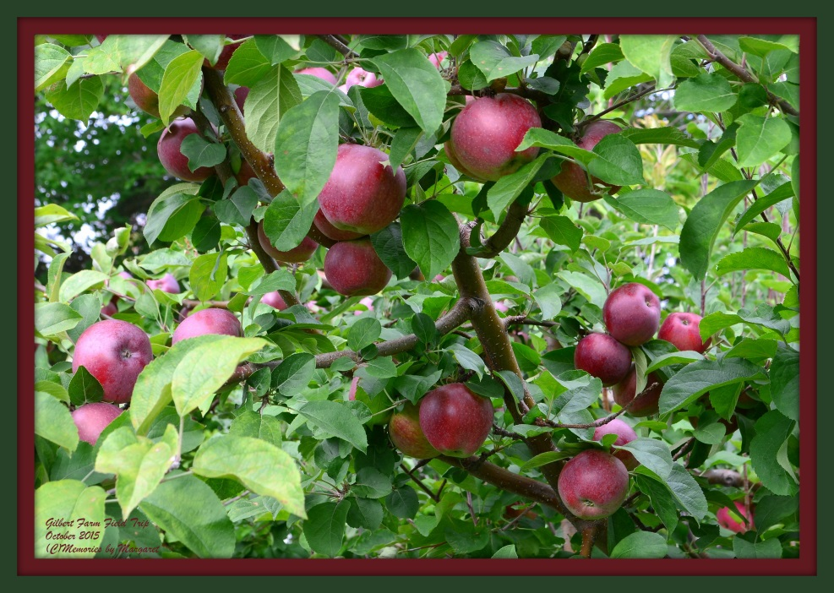

Slide 19
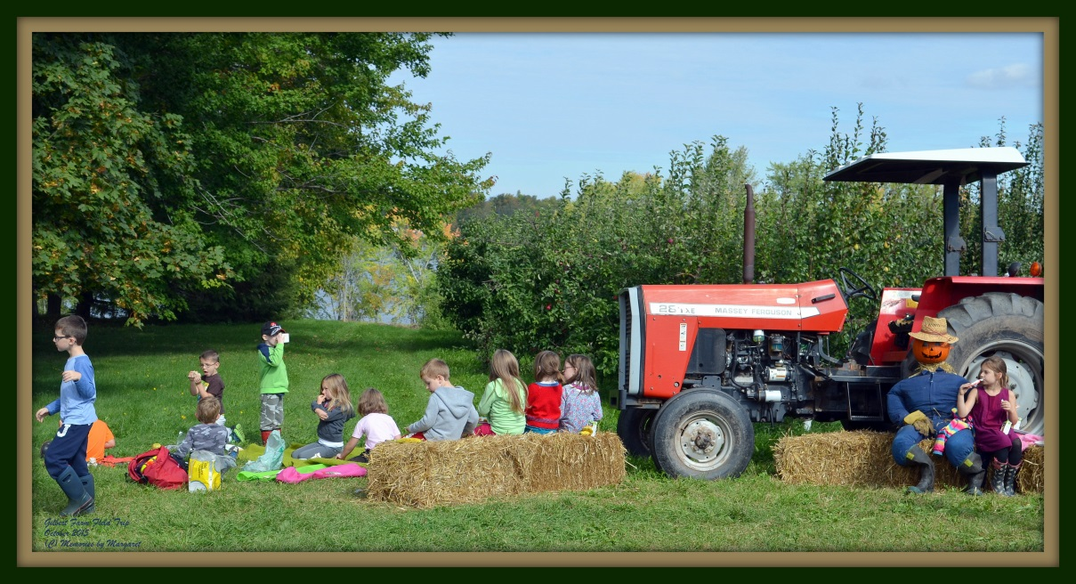
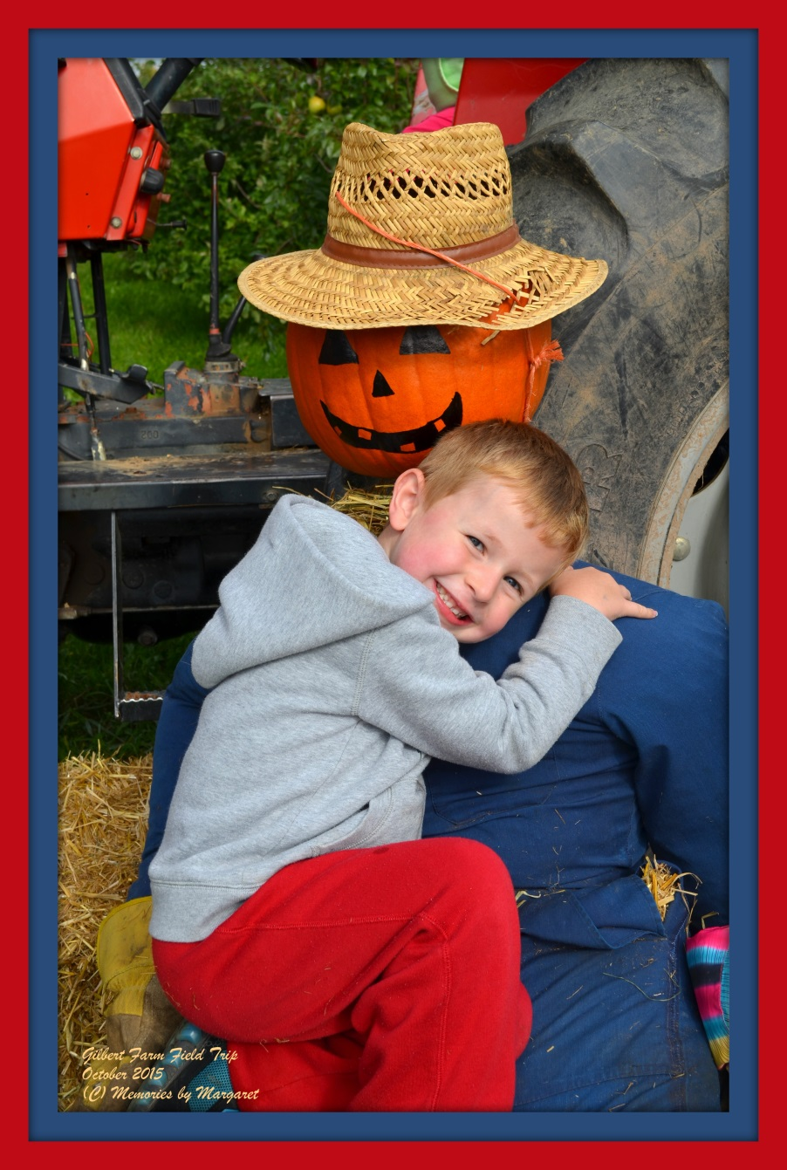
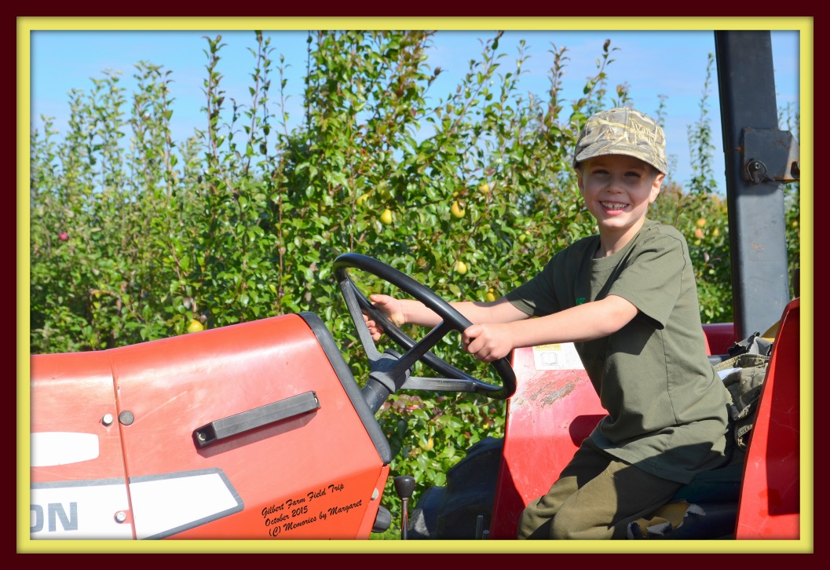
“Fun on the Farm”

Slide 20
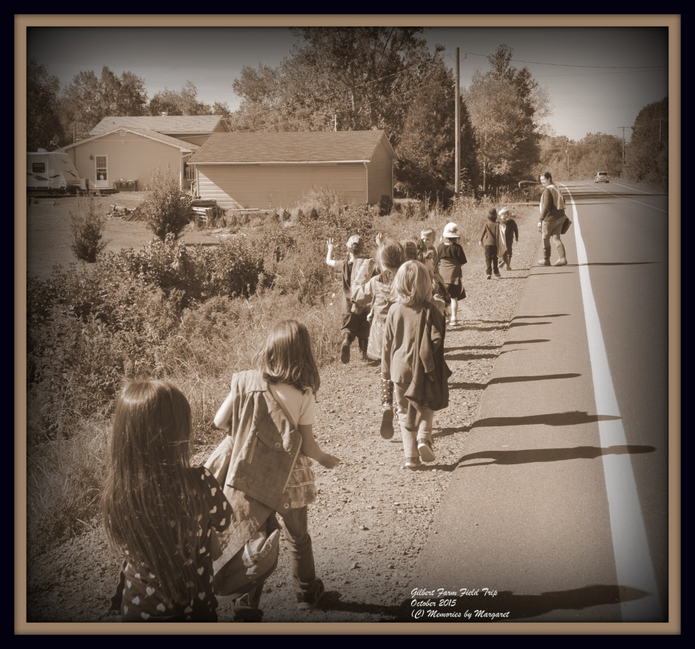
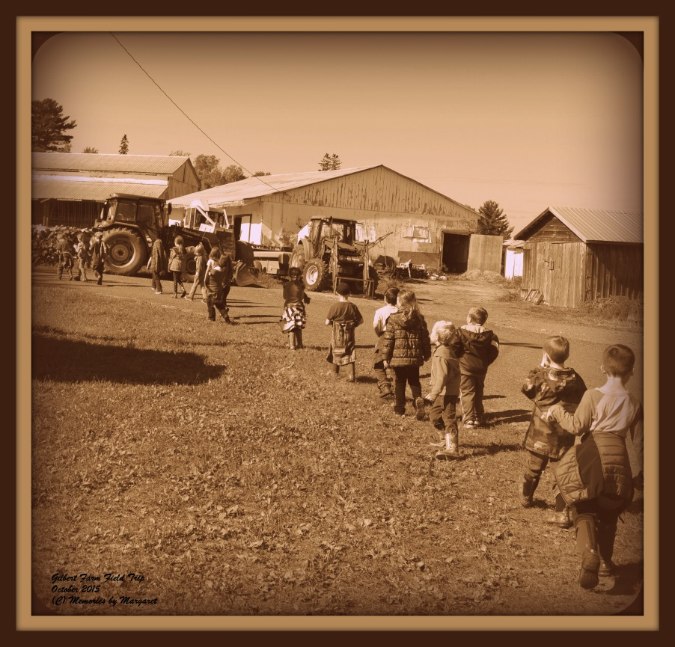
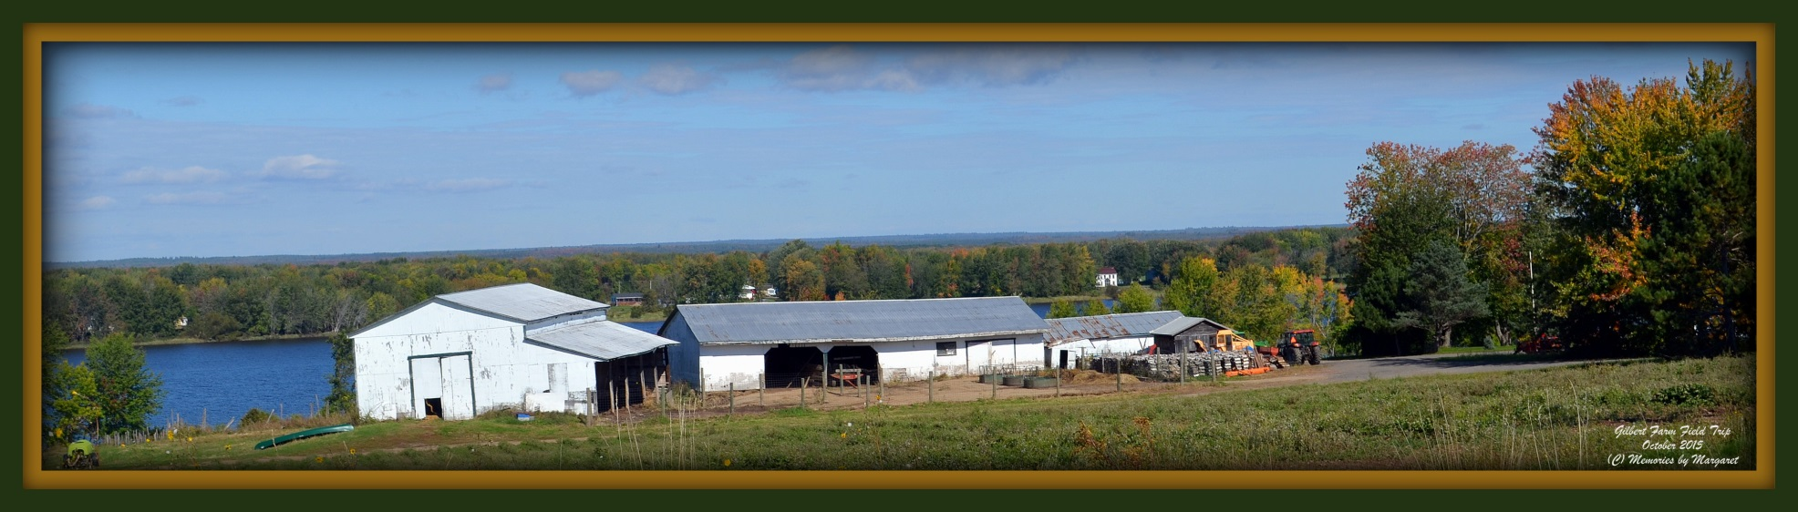
…....and back to school we go!
Goodbye Farm….Thank you

Slide 21
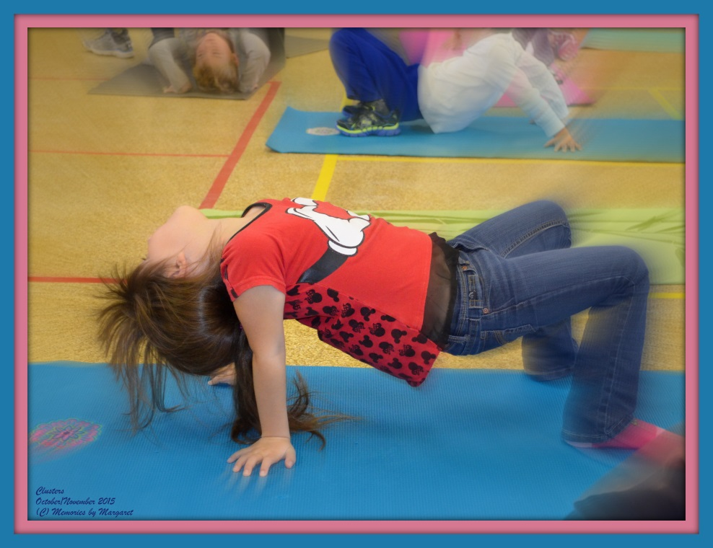
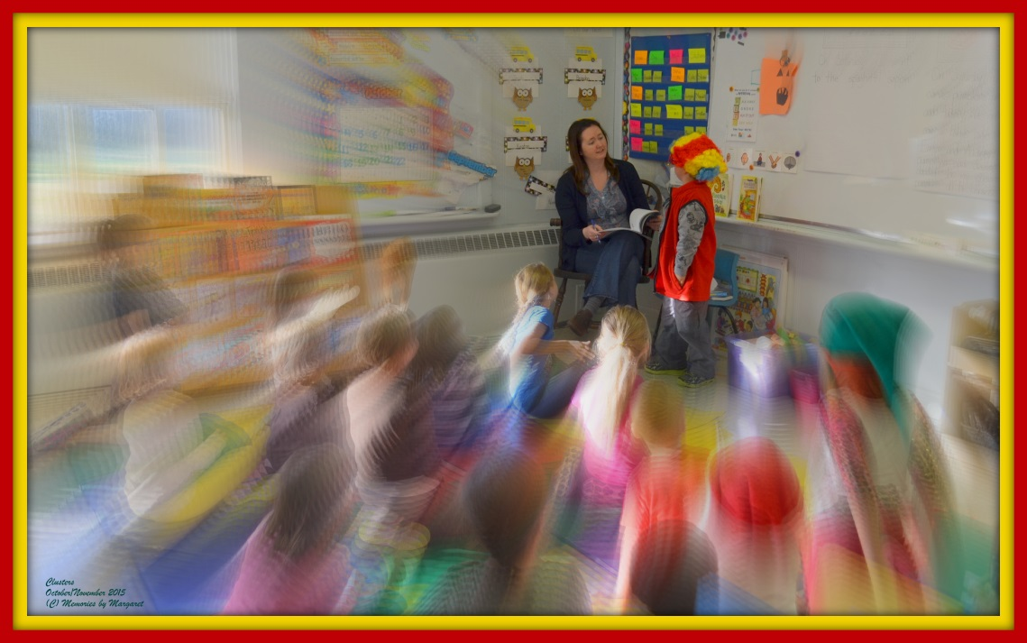
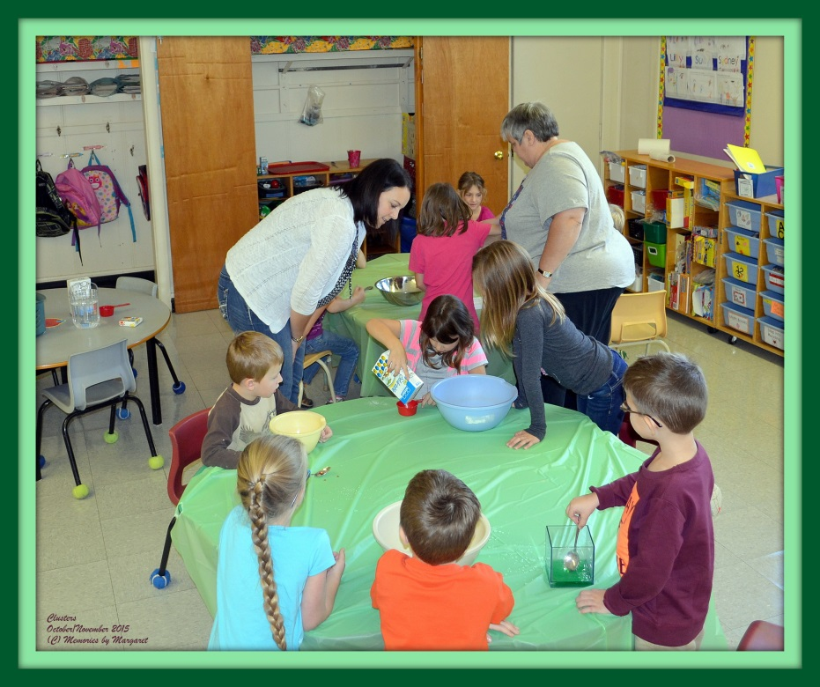
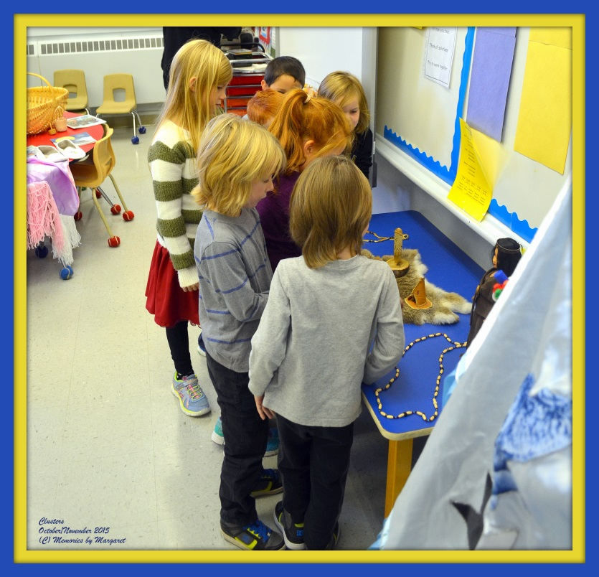
“Clusters”

Slide 22
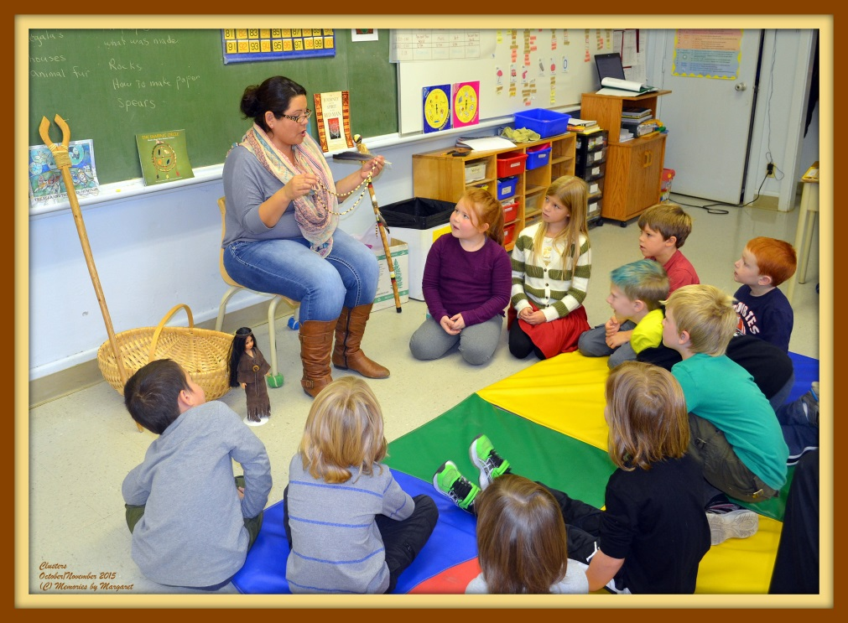
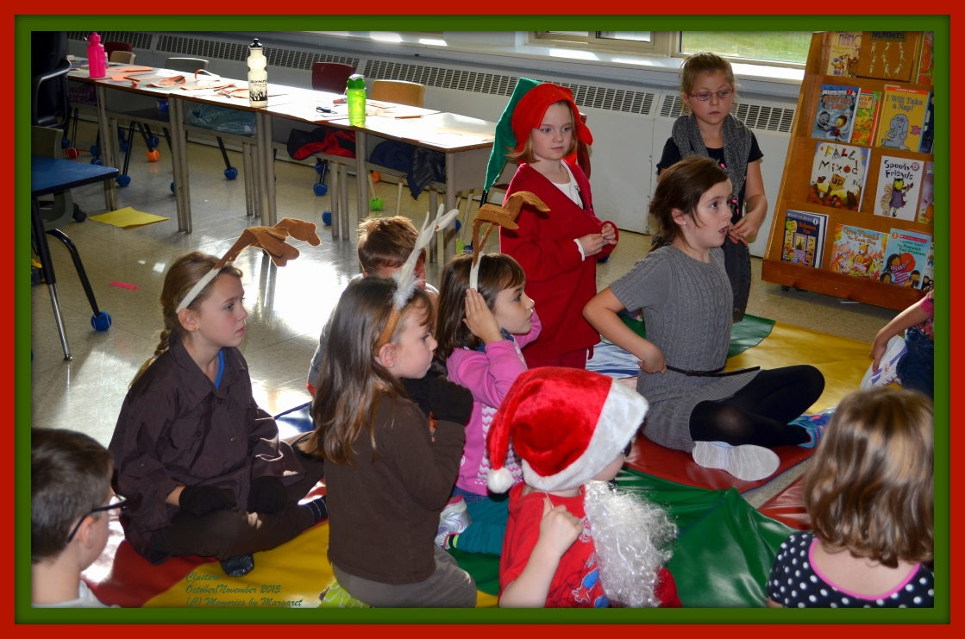
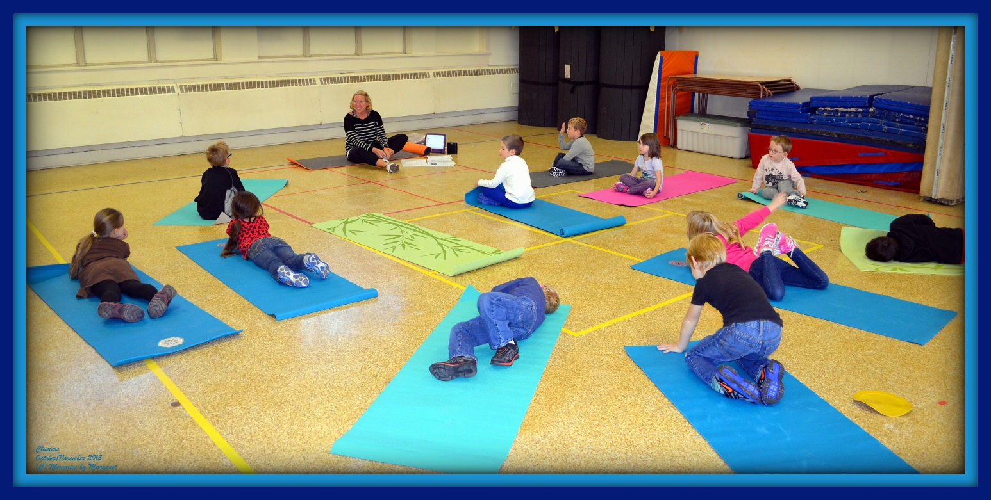

Slide 23
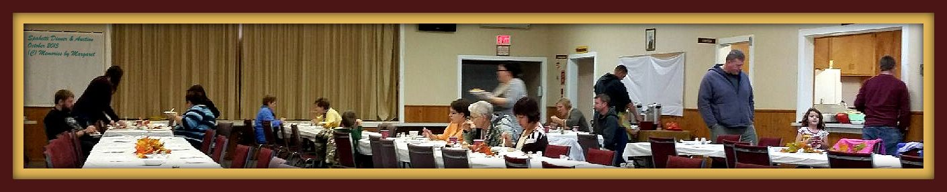
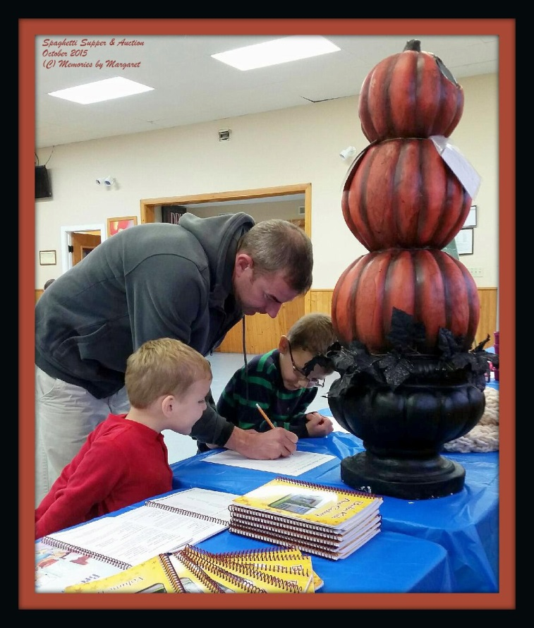
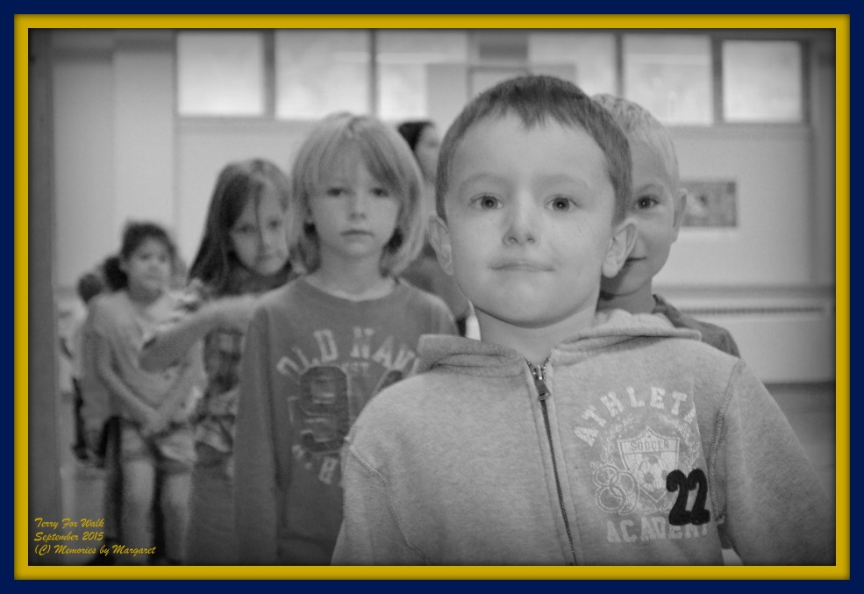
Fundraising
Spaghetti Dinner
Silent Auction
Terry Fox School Walk

Slide 24
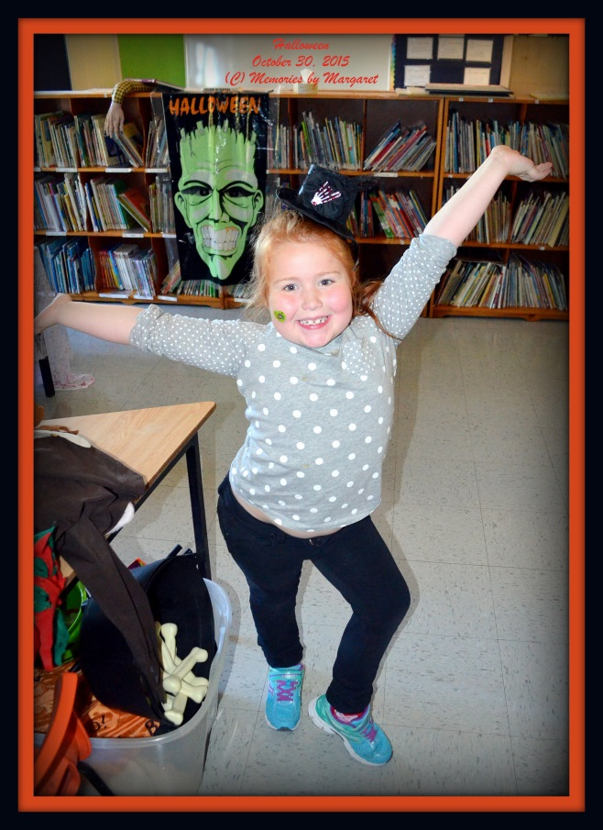




Halloween

Slide 25







Remembrance Day
“Thank You” to all the Veterans

Slide 26

…..…and the WINNER is......
Emily McMullin Grade 2
Won 2nd prize in the 2015 Legion Poster Colouring Contest. (November 2015)
Way to go Emily! ☺

Slide 27




Slide 28




November Awards Assembly

Slide 29



November Phys Ed Awards

Slide 30




One of the November Cluster Days

Slide 31


Skating = Phys Ed + Fun!

Slide 32




Final Clusters of this session…….

Slide 33
DEC members and
Superintendent McTimoney,
Please, let us stay and learn and grow in our own community, at
Burton Elementary School

Slide 34

Thank you for watching.
From the 2015-16 Students at Burton Elementary School

